Slide 1
Knowledge Management
UE17CS342
Project Title : Library Management System
Project Guide : Dr. Jayashree
Project Team : Tushar Raj - PES1201700221
Aditya Sivaram - PES1201700012
Sudarshan - PES1201700044
Anirudh - PES1201700659

Slide 2
Project Abstract and Scope
Library Management System:
To build a library management which contains two login :- student and admin(librarian).
Searching of books
Issuing and returning books
Users can see the current status of their issue along with the return dates.
Librarian can read information about any member
The books have been categorized for better maintainance.
Librarian can track the books issued by a particular student

Slide 3
Design Approach
As this is a library management system, it was designed keeping in mind the necessary functionality of a library.
All the required features such as login, signup, book search, book catalogue, late fine etc., are provided.
An easy to use and understandable UI has been created that allows the user to make maximum use of the features.
Basically it is a core knowledge managing app that collects data and organizes it to make the library data maintainable.

Slide 4
Knowledge Management concepts used
Tacit to explicit knowledge collection
Explicit to explicit knowledge collection
Process Map:
Capturing->Organizing->Refining->Transfer

Slide 5
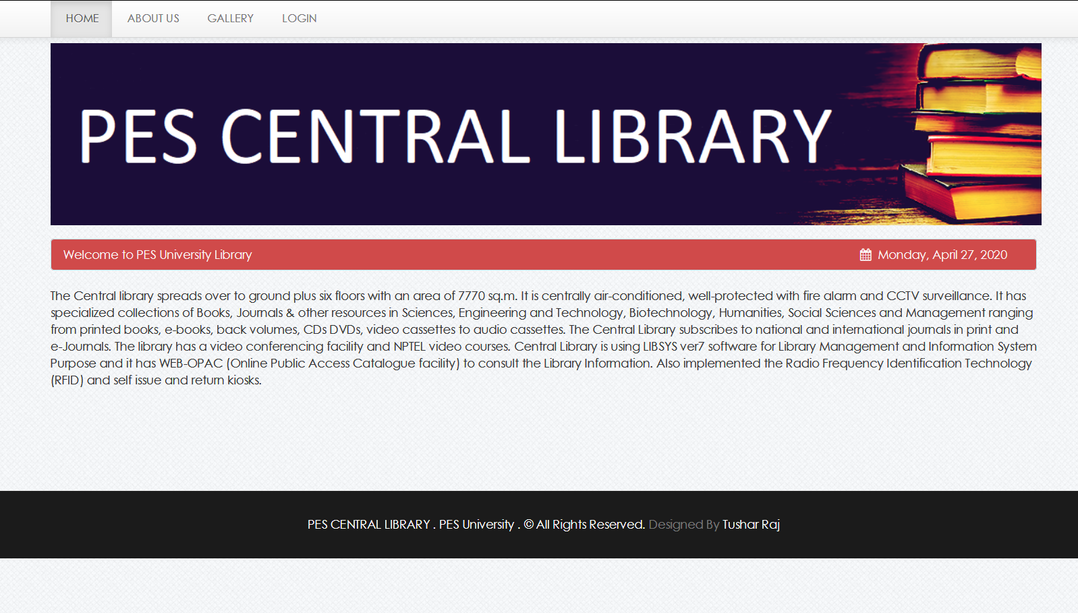
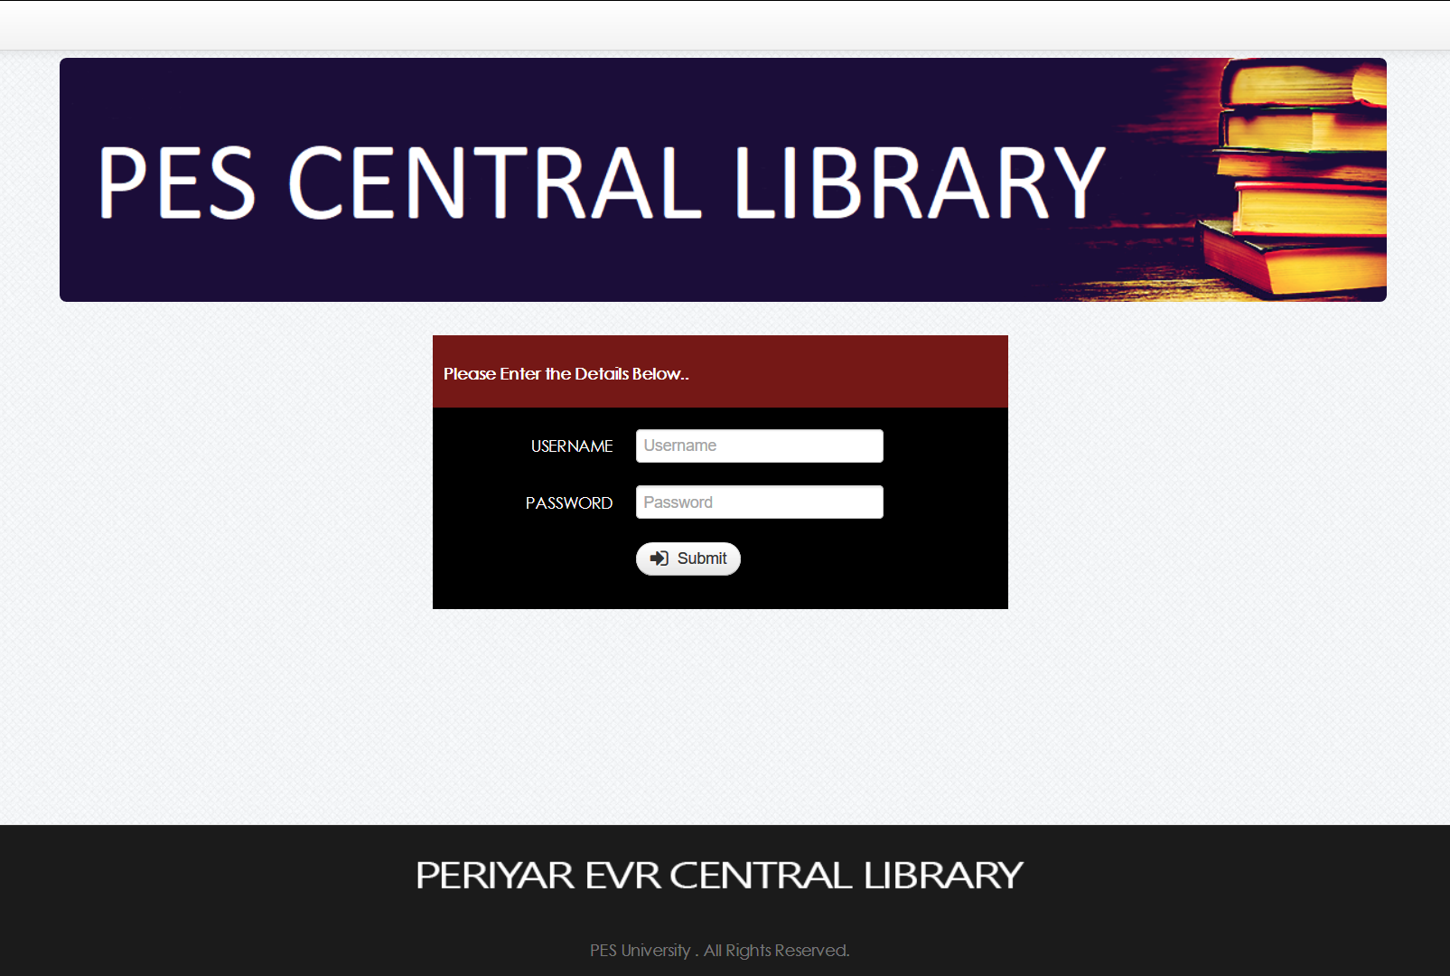
Design Description/UI Design
Landing page of our Library
Management
App.
Login page for librarians

Slide 6
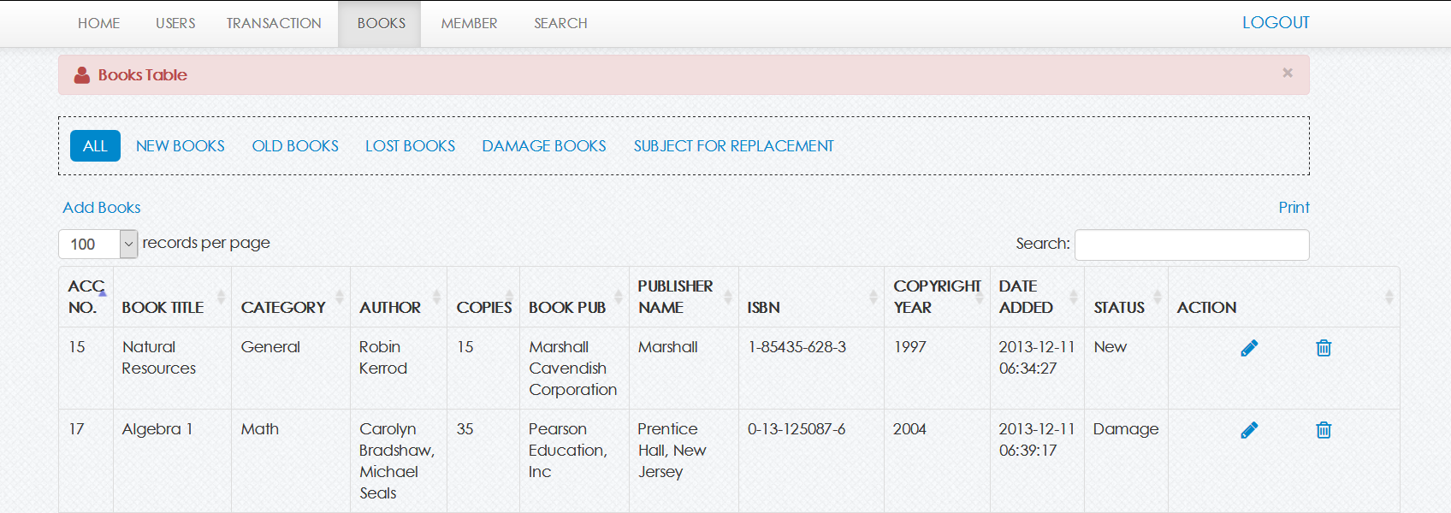
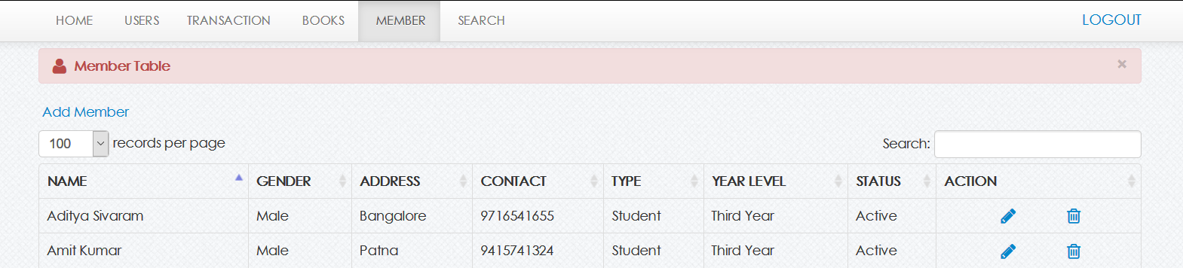
Design Description/UI Design
Book categorization for easy management.
GUI based edit delete buttons for maintaining details of a user.

Slide 7
Technologies Used
Backend:
PHP
Frontend:
CSS
HTML
JavaScript
Database:
MySQL
Notes:
7

Slide 8
Project Progress So far
We have created a fully functional website that provides the functionality of a library management system.
We researched on what features would be needed and then included them in the system
Notes:
8

Slide 9
Project Demo
Notes:
9

Slide 10
Thank You

